Slide 1
BLUFF
Sarcasm Detection for News Headlines
Aravind Venkateswaran z5208102 | Fatemeh Karbaschi z5335968 | Leonie Dickson z5215454 |
Terry Luo z5308257 | Veeraj Sharma z5113751

Slide 2


Problem Statement
Sarcasm is a common figure of speech and an important problem to solve to advance NLP
Unlike in sentiment analysis where the sentiment categories are very clearly defined, the borders of sarcasm aren’t that well defined since it is context-specific
Satirical news companies like The Onion or The Betoota Advocate publish sarcastic headlines
Aim: classify a news headline as sarcastic or not sarcastic

Slide 3
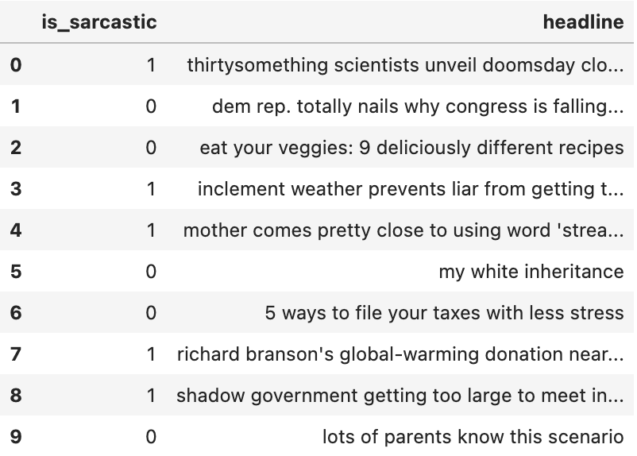
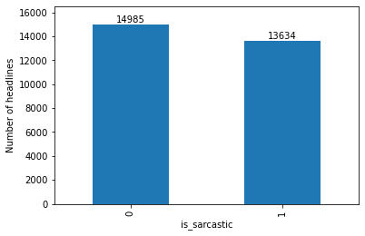
Data Source
News Headlines for Sarcasm Detection Dataset on Kaggle
Contains headlines from HuffPost (not sarcastic) and The Onion (sarcastic)
High quality text with no spelling or grammar errors
28619 headlines
Binary classification: classes are 1 (is sarcastic) and 0 (is not sarcastic)
Dataset is fairly balanced

Slide 4
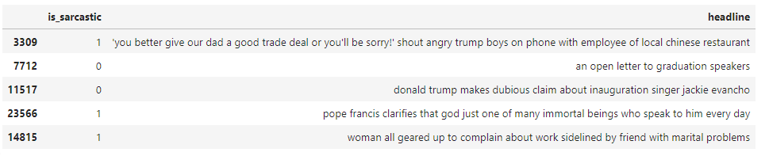
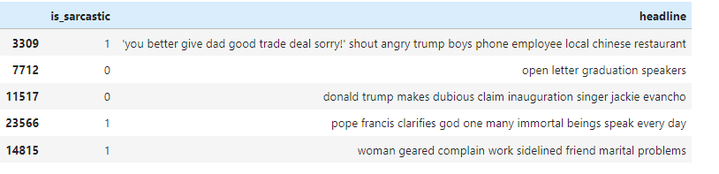
Data Preprocessing
Train.head() Before Preprocessing
Removing stopwords
Using NLTK library
Commonly used words which do not add much meaning eg. ‘a’, ‘the’
Removing HTML lines
Removing brackets
Train.head() After Preprocessing

Slide 5
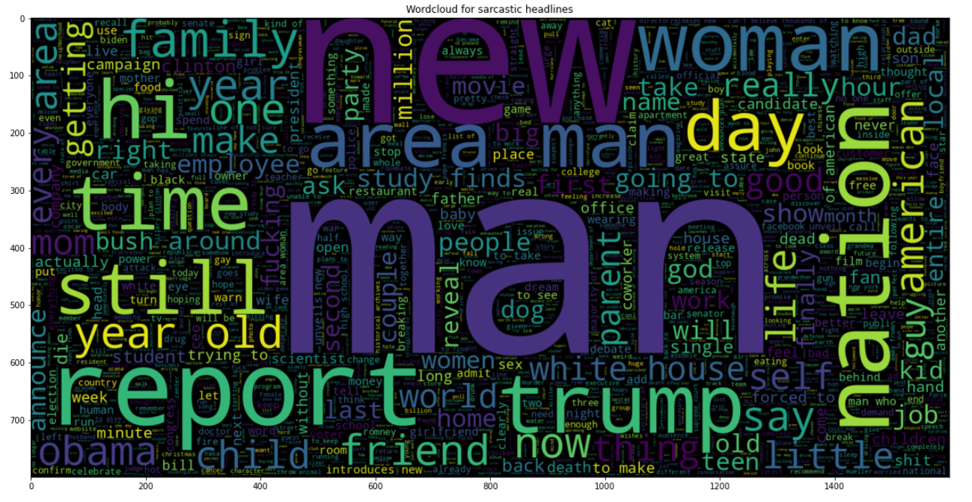
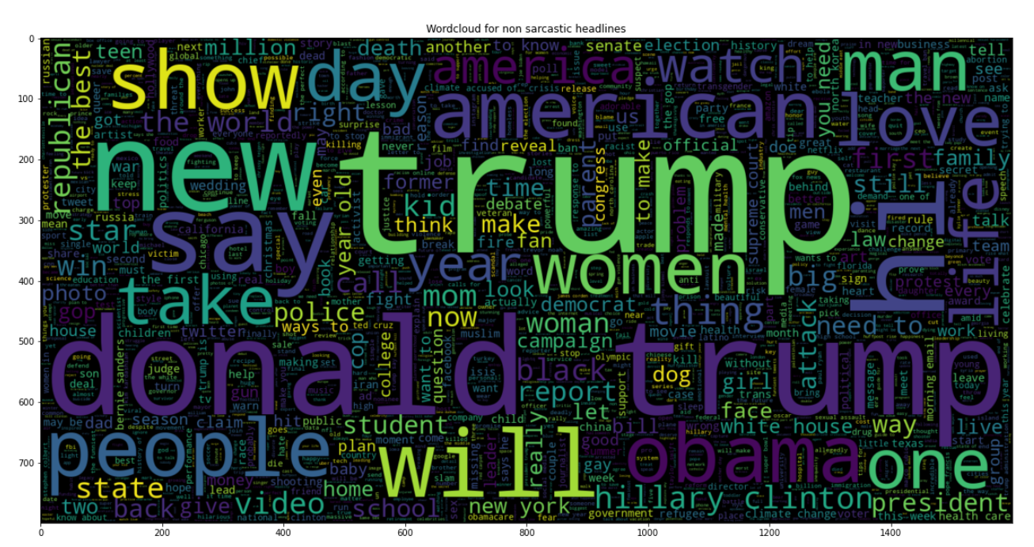
Word Cloud representation
for Sarcastic and Non sarcastic texts
Word Cloud for Sarcastic headlines
Word Cloud for Non sarcastic headlines

Slide 6
Methods
Preprocess data and use pretrained vector library and API for modelling
Lightweight variation of BERT, fine-tuned with a linear layer for classification
(GloVe / ELMo / Word2Vec)
FastText
Ensemble 1
DistilBERT
Ensemble Final
Create embedding vectors that can be used in a classification model
Weight models using MCC (Matthews’ Correlation Coefficient)
Optimal weighting between Ensemble 1 and DistilBERT used to maximise MCC

Slide 7
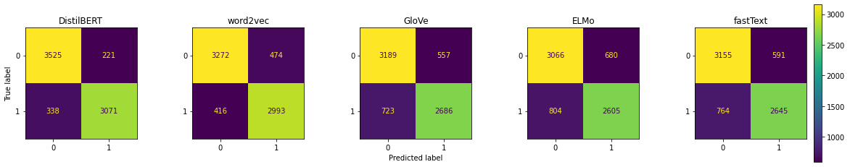
Results
Confusion Matrix
Predicted class
1
0
True Negative | False Positive
False Negative | True Positive
Actual class
1
Number of correct and incorrect predictions for each model
0
Notes:
Note about confusion matrix: The number of false negatives is more than number of false positives

Slide 8
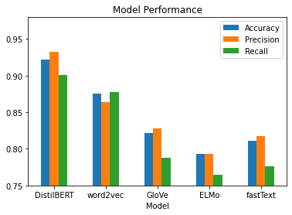
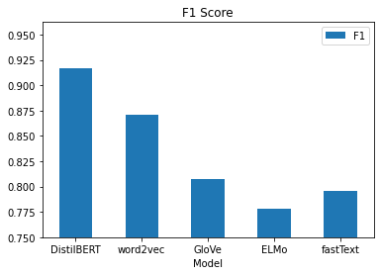
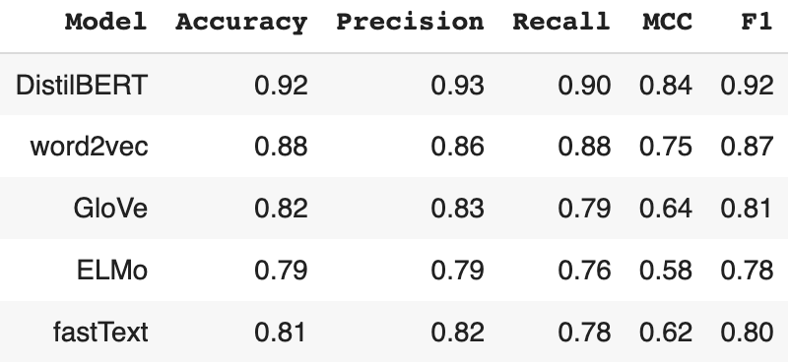
Results
Models Performance
Comparison based on
Accuracy, Precision,
Recall, MCC and F-Measure
Notes:
MCC: Correlation between the actual results and the preded values

Slide 9
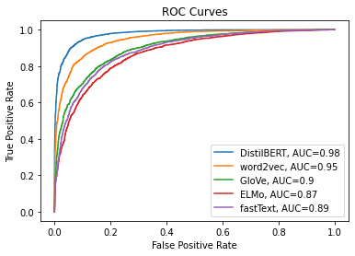
Results
ROC (Receiver Operating Characteristics)
AUC (Area Under The Curve)
AUC closer to 1 means better the performance of the model in binary classification

Slide 10
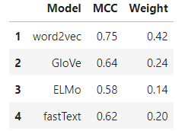
Ensemble Modelling
Goal: Improve on our model performance by forming an ensemble
Initial ensemble
Combine the 4 underperforming models
Weight each model using Matthews’ Correlation Coefficient
Compute combined prediction probabilities
Initial ensemble (MCC: 0.77) performed slightly better than Word2Vec (MCC: 0.75)
However, it still underperforms our top model (DistilBert with MCC: 0.84)
Performance of Initial Ensemble
Accuracy | 0.89
Precision | 0.88
Recall | 0.88
MCC | 0.77

Slide 11
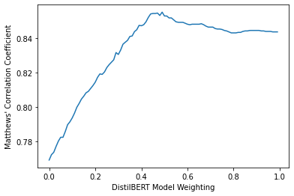
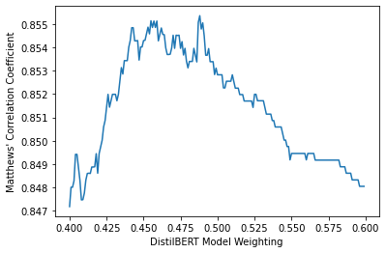
Ensemble Modelling
The next step was to weight this initial ensemble with the DistilBERT model.
Found the optimal weighting for the DistilBERT model to maximize MCC
Maximum final ensemble MCC is given for a 49:51 weighting between DistilBERT:Initial Ensemble

Slide 12
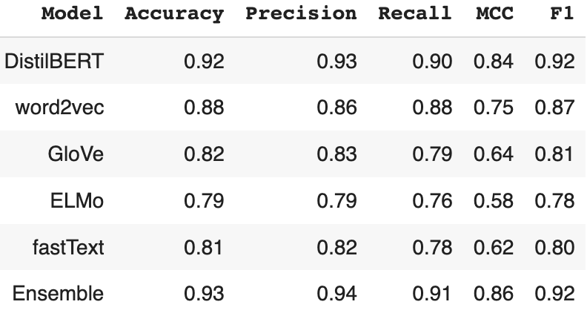
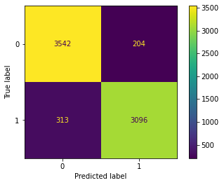
Final Ensemble
The Final Confusion Matrix

Slide 13
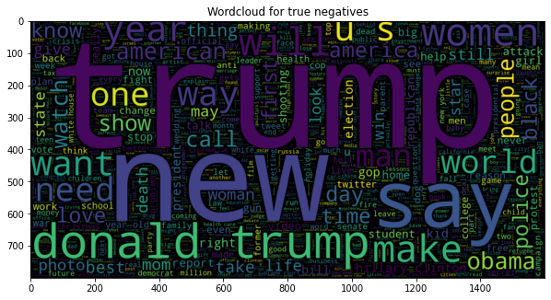
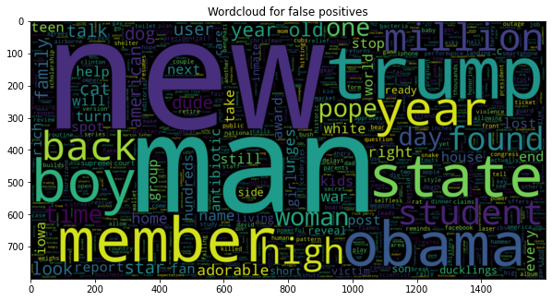
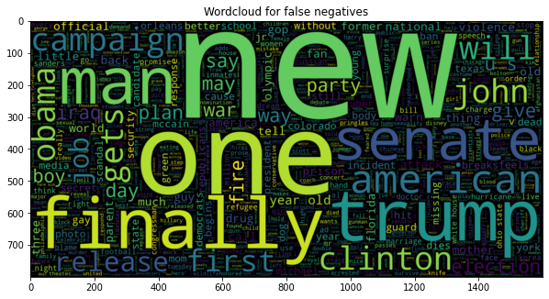
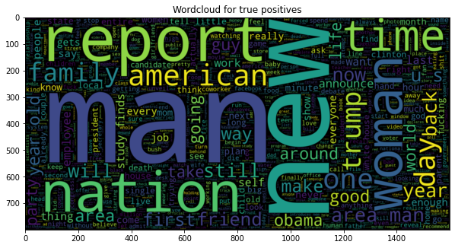
Word clouds produced from model classification of headlines

Slide 14
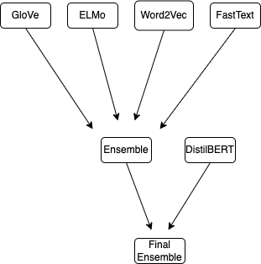
Conclusion
Producing an ensemble model using different NLP methods was able to boost model performance
At 93% accuracy, model would not be ready to replace human judgment
Limitation: computationally expensive and less explainable
Much more outside context needed to truly detect sarcasm
Model may struggle with news headlines in other contexts (eg. news from Australia, news in the future)

Slide 15
Citations
https://mccormickml.com/2019/07/22/BERT-fine-tuning/?fbclid=IwAR3pn4h2dNhxedWdxkDSEQ4k6WcIEA-8pNxkOCbmCe2eaMoo1rX5KHPd-YE
Chicco, D., Jurman, G. The advantages of the Matthews correlation coefficient (MCC) over F1 score and accuracy in binary classification evaluation. BMC Genomics 21, 6 (2020). https://doi.org/10.1186/s12864-019-6413-7

